Slide 1

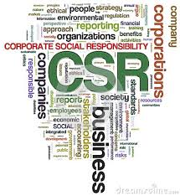
BENEFITS OF CSR
Career Development Centre
SRMIST – kattankulathur

Slide 2
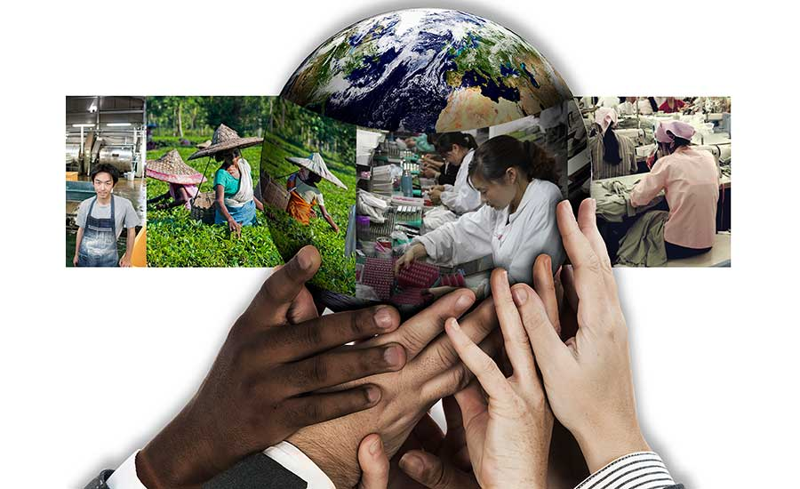
BENEFITS OF CSR
CSR is the way to show the human face of your business.
It is connecting through
human language showing
humanity.
Contributing to the
Society and its people.
Career Development Centre
SRMIST – kattankulathur

Slide 3
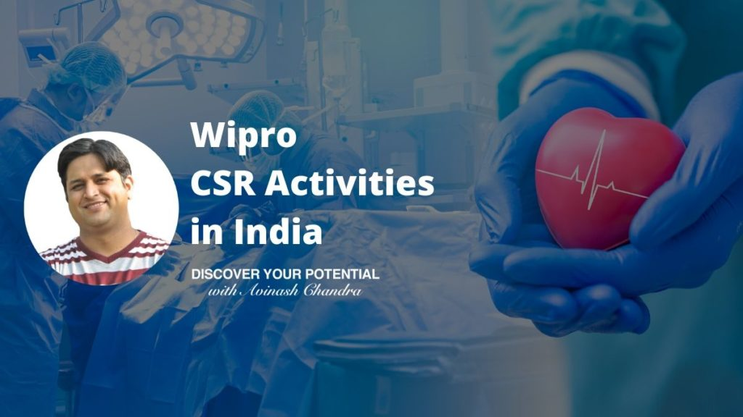
Benefits of CSR
CSR initiatives can be the best
way to contribute to the
society and its people.
Through local or national
charitable contributions
businesses can help the
society
Career Development Centre
SRMIST – kattankulathur

Slide 4
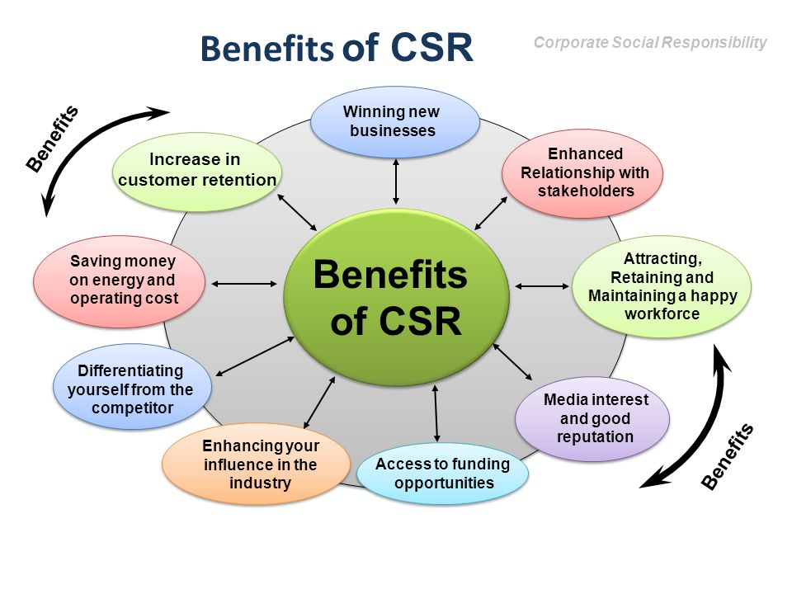
Benefits of CSR
Career Development Centre
SRMIST – kattankulathur

Slide 5
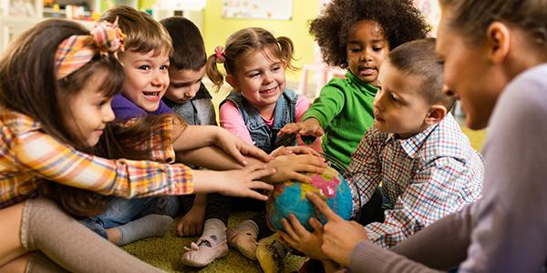
Value Diversity & Building Relationships
Career Development Centre
SRMIST – kattankulathur

Slide 6
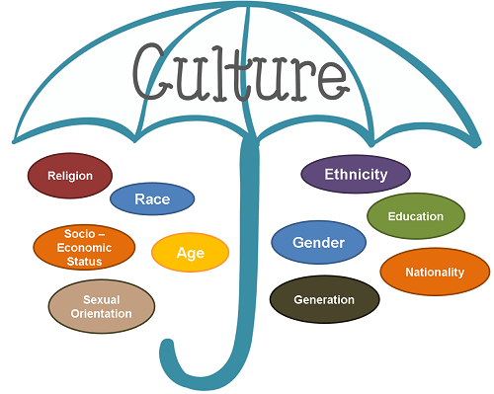
Culture
Culture refers to a group or community which shares common experiences that shape the way its members understand the world.
Career Development Centre
SRMIST – kattankulathur

Slide 7
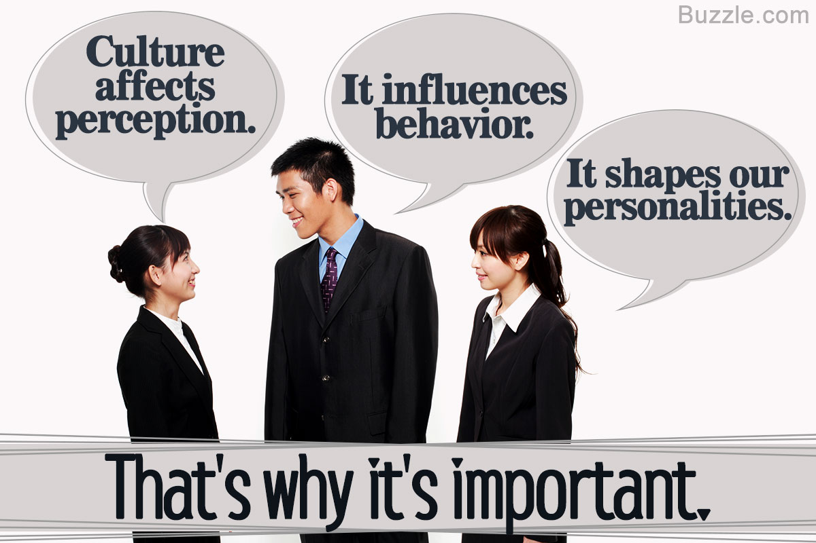
Why is culture important?
Culture is strong part of
people’s behaviour.
It influences their views,
their values, their humour,
their hopes, their loyalties,
and their worries and fears.
Career Development Centre
SRMIST – kattankulathur

Slide 8
Why is understanding culture important?
It is becoming clear that in order to build communities that are successful at improving conditions and resolving problems, we need to understand and appreciate many cultures, establish relationships with people from cultures other than our own, and build strong alliances with different cultural groups.
Career Development Centre
SRMIST – kattankulathur

Slide 9
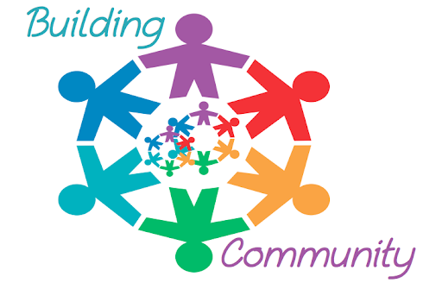
Understanding Culture
In order to build communities that are powerful enough to attain
significant change, we
need large numbers of
people working together .
Career Development Centre
SRMIST – kattankulathur

Slide 10

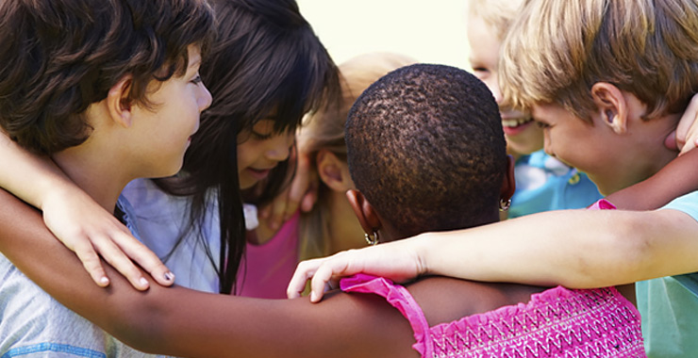
Understanding Culture
Each cultural group has
unique strengths and
perspectives that the larger
community can benefit from.
Understanding cultures
will help us overcome
and prevent racial and
ethnic divisions .
Career Development Centre
SRMIST – kattankulathur

Slide 11

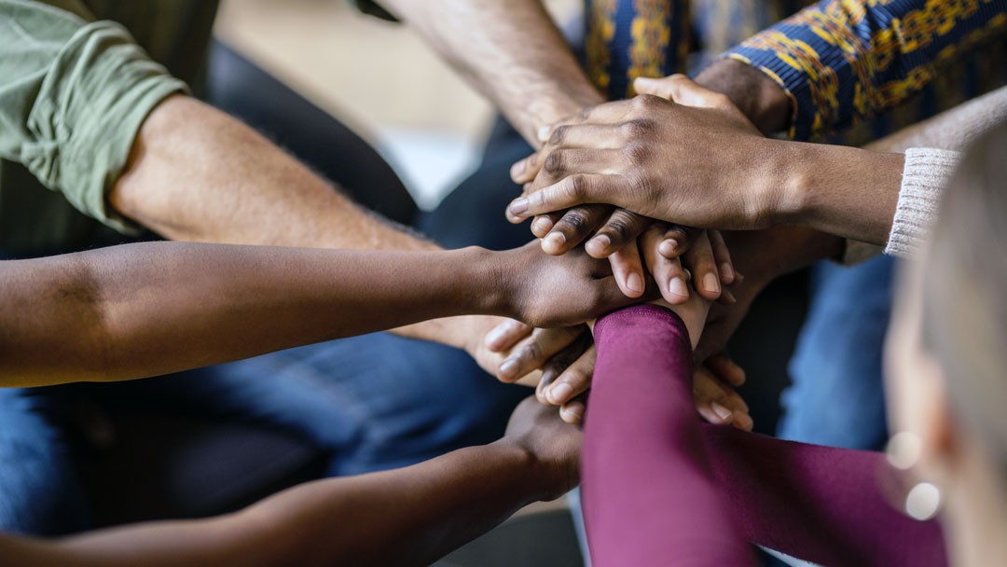
Understanding Culture
People from different cultures
have to be included in
decision-making processes
in order for programs or
policies to be effective .
An appreciation of cultural
diversity goes hand-in-hand
with a just and equitable
society .
Career Development Centre
SRMIST – kattankulathur

Slide 12
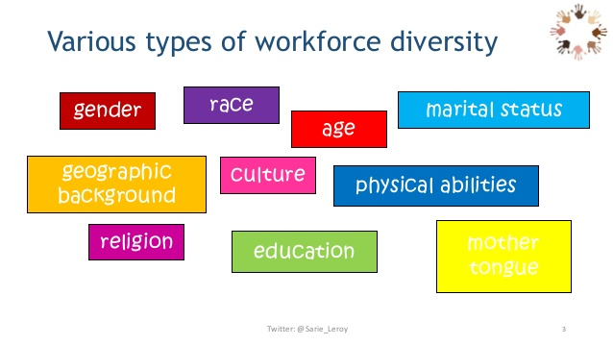
Diversity Issues When Developing Work Relations with Colleagues
Issues that could divide us in workplace
Language
Differences in Values and Etiquette
Tone of voice
Clustering
Communication
Tolerance
Religious issues
Workplace issues
Career Development Centre
SRMIST – kattankulathur

Slide 13

Overcoming Issues
Showing respect in
small ways can build
trust despite diversity
Learning how to say a
colleague’s name
correctly.
Setting aside your beliefs, assumptions and judgments to see through other’s cultural lenses
Career Development Centre
SRMIST – kattankulathur

Slide 14
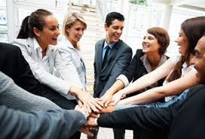
Why have good relationships?
Better the relationship at work leads to happiness and more productivity
Work becomes more enjoyable
Getting along with changes
Becoming innovative and creative
Gives more freedom and focus on opportunities
To develop our career and develop working relationship in the professional circle.
Career Development Centre
SRMIST – kattankulathur

Slide 15
Defining good relationship
Characteristics that make up good relationship:
Trust
Mutual Respect
Mindfulness
Welcoming Diversity
Open Communication
Career Development Centre
SRMIST – kattankulathur

Slide 16
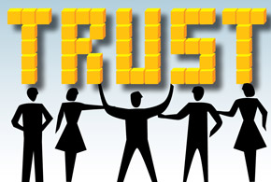
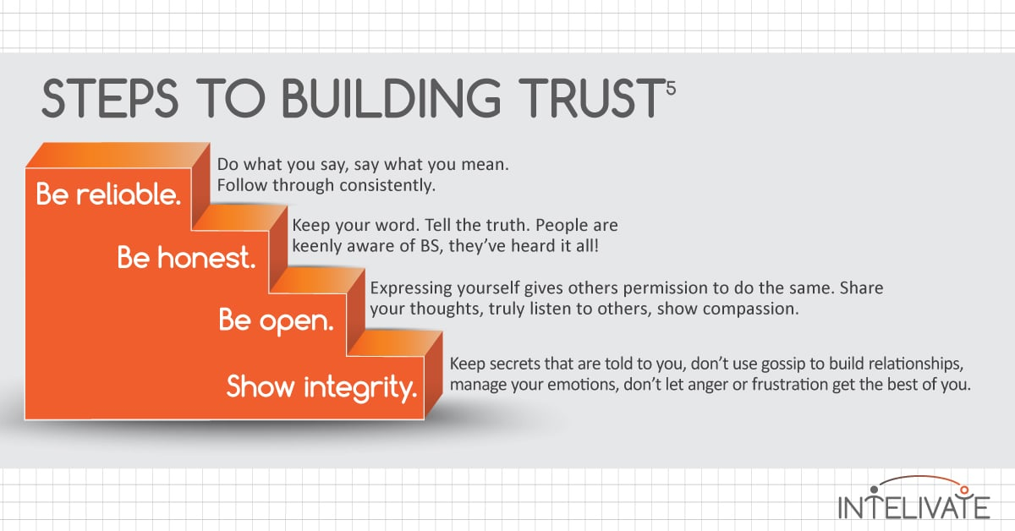
Defining Good relationship- Trust
Foundation of a good relationship
Helps communicate effectively.
You can be open and honest with
your thoughts and actions.
Career Development Centre
SRMIST – kattankulathur

Slide 17
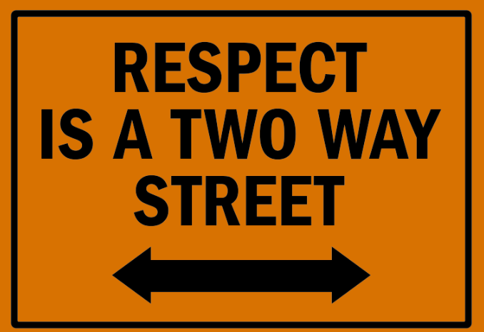
Mutual Respect
When you respect people and value their ideas they value yours.
Can build solutions based
on your collective insight
wisdom and creativity.
Career Development Centre
SRMIST – kattankulathur

Slide 18
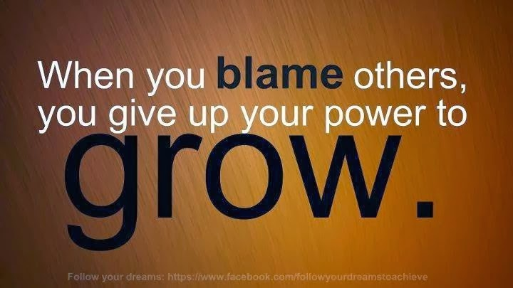
Mindfulness
Taking responsibility for your words and actions.
Mindful people are careful about
what they say.
Mindful people don’t let negative
emotions impact people around
them
Career Development Centre
SRMIST – kattankulathur

Slide 19

Welcoming Diversity
People with good relationship welcome diversity
Not only accommodating
others’ opinions but
welcoming them and
factoring their insights
into your decision
making.
Career Development Centre
SRMIST – kattankulathur

Slide 20
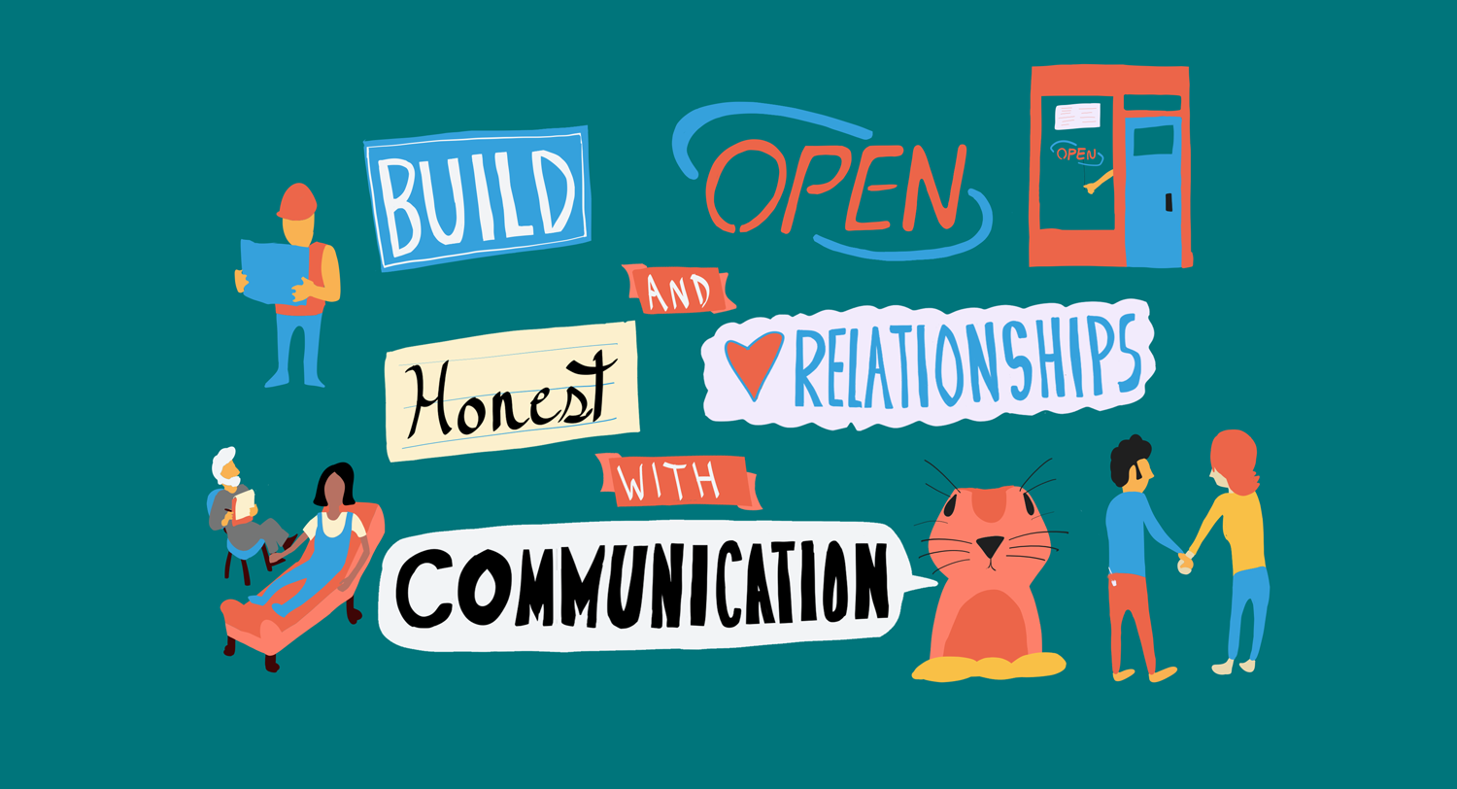
Open Communication
Communicating effectively
with those around you to
make your relationship richer.
All good relationship depends
on honest communication.
Career Development Centre
SRMIST – kattankulathur

Slide 21

Career Development Centre
SRMIST – kattankulathur

